Slide 2
Excel Hacks for Budget Preparation
Catherine Shults, cmshults@wisc.edu
Research Administrator, Department of Mechanical Engineering
And
Chrystin Schultz, chrystin.schultz@wisc.edu
Pre-Award Administrator, College of Engineering Dean’s Office

Slide 3
Learning Objectives
Understanding the basics
How to read a formula and cell references
Copying formulas – dragging and autofill
Absolute/Relative/Mixed cell references
Tips and Tricks
Quick Access Toolbar
SumTotal Bar
Goal Seek
Conclusion, Resources, and Questions
Notes:
CMS

Slide 4

Why do we care about Excel?
Is your template calculating what you think it is?
Understanding basic Excel functionality will give you the confidence to explore the broader functionality of this essential tool and its applications in Research Administration in more complicated situations.
Notes:
CMS -

Slide 5
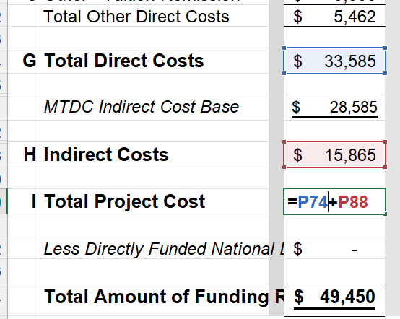
Understanding a Basic Formula
Excel formulas and functions are the backbone of data analysis:
Perform calculations
Analyze data
Automate tasks
Components of a basic formula
All formulas and functions begin with the Equals Sign =
One or more cell references
May contain an operator: (+, -, *, /)
Notes:
CRS - Point out that cell reference colors match the highlighted cells

Slide 6
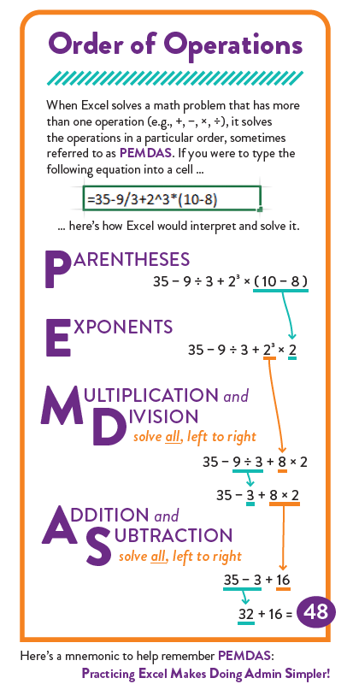
Order of operations
In mathematical expressions (including Excel formulas) that contain more than one mathematical operation, the standard order of operations determines the order in which the operations are solved. The standard order is often referred to by the mnemonic acronym PEMDAS, which helps you remember the order: Parentheses first, followed by Exponents, Multiplication and Division (solved from left to right), and finally Addition and Subtraction (solved from left to right). The graphic to the right illustrates how this works.
Graphic credit Larisa Roberts and Scott Templeton
Notes:
CRS

Slide 7
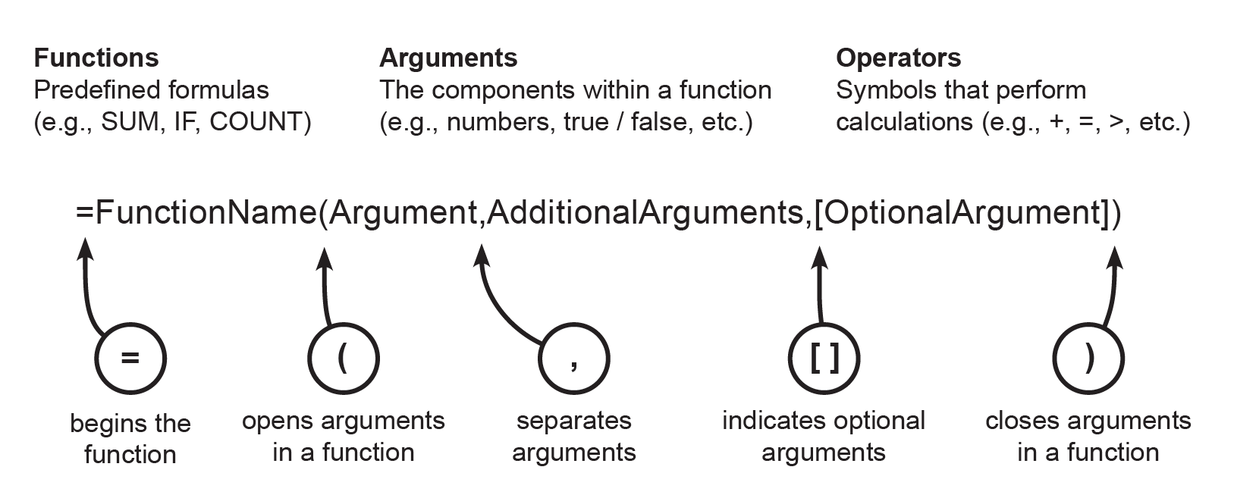
What is a function?
Graphic credit Larisa Roberts and Scott Templeton
Notes:
CRS - A function is like a prebuilt recipe to perform a certain calculation or task.
Function name = your recipe name/title
Arguments = ingredients
Operators = instructions

Slide 8
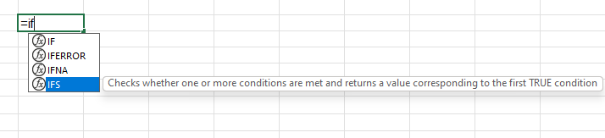
Function Tips
TIP: When you start typing the name of a function, Excel will suggest available options in the tooltip. Next to the name of the function is a description of what it does. You can scroll or arrow through them and select by pressing tab or double clicking.
Notes:
CRS - Also mention the function menu

Slide 9

Function Tips
TIP: Once you type the open parenthesis, Excel provides another tooltip. The tooltip tells you what arguments are needed to perform the function. The bold argument indicates your location in the function. Arguments in square brackets are optional.
The below example is a lookup function that returns a value based on the parameters you’ve set up. If you are familiar with Vlookup, this is an updated, more intuitive option. It combines well with many logic-based functions.
Notes:
CMS - Excel tells you what ingredients you need.
Also say what this particular function can be used.
Brackets – optional

Slide 10
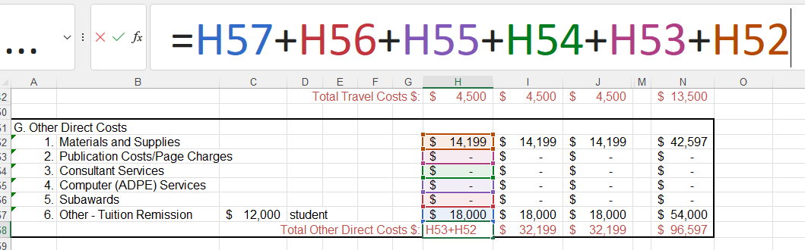
Writing Formulas and Functions
Type = and then select individual cells.
Notes:
CRS - Individual cells selected.

Slide 11
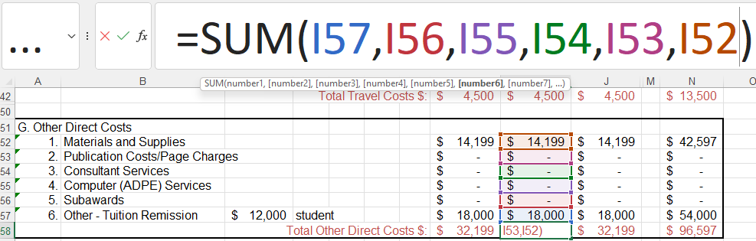
Writing Formulas and Functions cont.
Type =Sum( and then select individual cells.
Notes:
CRS – Again individual cells selected

Slide 12
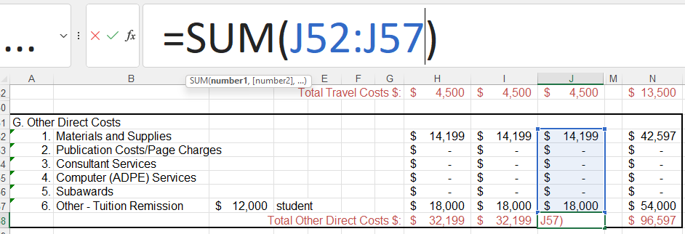
Writing Formulas and Functions cont.
Type =SUM( and select a range of cells with your mouse
Notes:
CMS - Brief demo of adding a row to demonstrate that this version adapts when the range expands while the other ways will now have an incorrect sum.

Slide 13
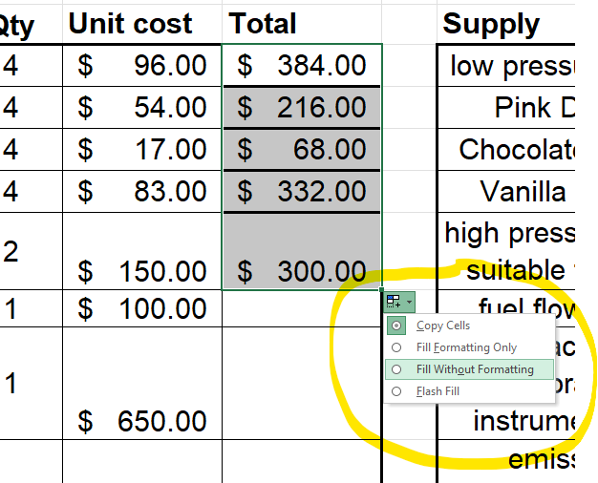
Copying formulas by dragging them
You can copy a formula down a column or across a row by dragging it.
Select the cell containing the formula
Move your cursor to the bottom right of the cell to make the Fill Handle appear (small black cross)
Drag down or across as desired
You can also double click the fill handle and Excel will copy the formula down until it reaches a blank cell in the adjacent column
TIP: The Autofill Options menu that appears when copy a formula in either of these ways will give you options to change the formatting of the destination cells
Notes:
CRS - Demonstrate this using Homer’s Supply tab

Slide 14

Referencing cells on other tabs
References to cells on other tabs will begin with the tab name followed by an exclamation point. In the above example the yellow highlighted selection references the cell ranges on the Supplies tab, while L3 references cell L3 on the tab where the function appears.
Notes:
CRS- Right? The cell range in yellow is from another tab, while L3 is referencing a cell on the same sheet as the formula appears.
More on the dollar signs later in the presentation

Slide 15
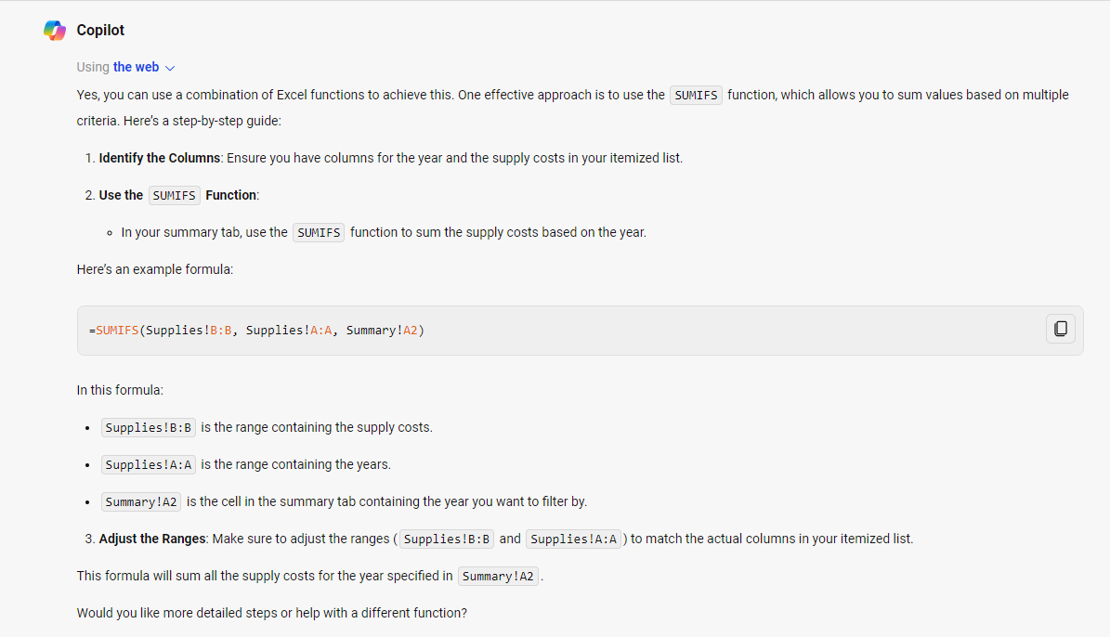
You can use AI to help you!
Input: I have an Excel budget with a tab named Summary where my full budget appears and a tab named Supplies for itemizing supplies. I want to populate the supply line on the Summary tab based on the year defined in the itemize list on the Supplies tab. Is there a function that can that will do this?
Notes:
CMS
AI is interactive and you can provide very specific info about what you are trying to do
You can also use it to troubleshoot syntax or other problems

Slide 16
Absolute, Relative, and Mixed Cell References
Relative References - changes when a formula is copied to another cell. If you have a formula in cell B1 that refers to cell A1 (as in, =A1), and you copy this formula to cell B2, the formula will automatically adjust to =A2. Excel updates the reference relative to the position of the cell the formula is in.
Absolute References - is a cell address that remains fixed even when the formula is copied or moved to another cell. It’s denoted by a dollar sign $ before the column letter and before the row number, such as $A$1. No matter where you copy this formula, it will always refer to cell A1.
Mixed references - are a combination of absolute and relative references. They have a dollar sign $ before either the column letter (e.g., $A1) or the row number (e.g., A$1). In the first example, column A is absolute and will not change when copied across columns, but the row number is relative and will change when copied down rows. The second example is the opposite.
Notes:
CMS - Define and then demonstrate using Absolute – Relative Reference tab

Slide 17
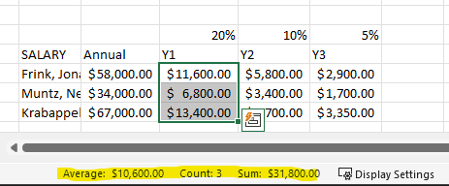
SumTotal Bar

Slide 18
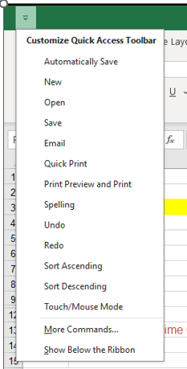

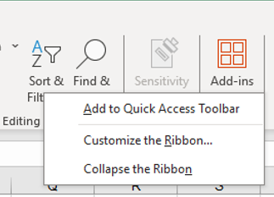
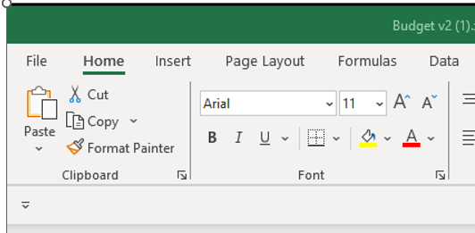
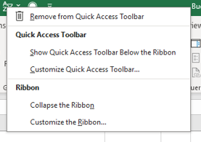

Quick Access Toolbar!
Notes:
CRS – Put your quick access over or under based on our preference. Quick add from the drop down or right click over a function/command and select Add
Auto-hide hides ALL top functions in Excel
Show Tabs- only shows name of functions

Slide 19
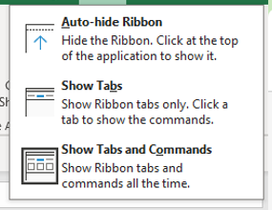
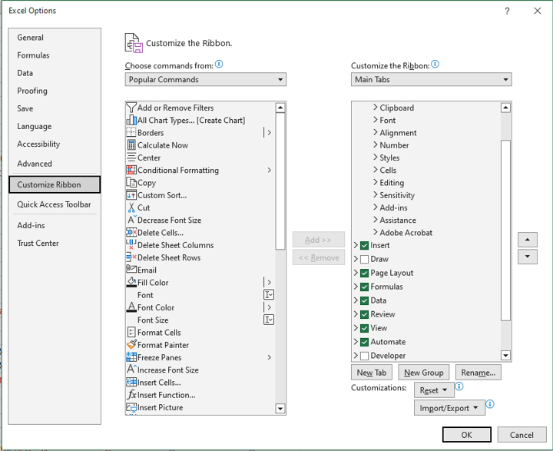


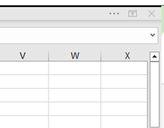
Quick Access Toolbar!
Notes:
CRS –Auto-hide hides ALL top functions in Excel
Show Tabs- only shows name of functions
Show Tabs and Commands
Customize the Ribbon-Large scale Dump!

Slide 20
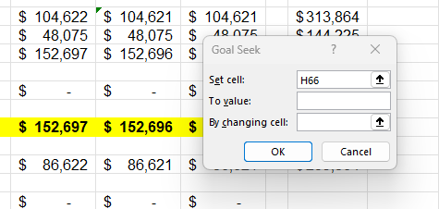
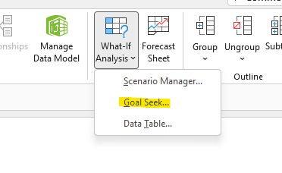
Goal Seek
Goal Seek is located on the Data tab near the right side in the What-if Analysis drop down menu.
The Set cell MUST contain a formula
The To value cell is the value you are trying to reach
The By changing cell MUST be in some way linked to the Set cell by a formula. It MUST be a value and cannot contain a formula itself.
Notes:
CMS - Define and then demonstrate. $150K is a good number to use because Goal Seek has to think and it actually comes up with $149,999.
Other problems that can arise
Error because By Changing Cell is not a value
Excel can’t find a solution – Remove rounding to solve.

Slide 21
Resources
LinkedIN Learning https://it.wisc.edu/services/online-training-linkedin-learning/
YouTube Videos – There are many. This one is a former UW Research Admin and more specific to our roles: https://www.youtube.com/@excel-spark
Blogs
Ask your favorite Artificial Intelligence chatbot
Colleagues!

Slide 22

Questions?
Notes:
Resources
YouTube
AI
Blogs
Your colleagues!

Slide 23
Excel Hacks for Budget Preparation
Catherine Shults, cmshults@wisc.edu
Research Administrator, Department of Mechanical Engineering
And
Chrystin Schultz, chrystin.schultz@wisc.edu
Pre-Award Administrator, College of Engineering Dean’s Office

